Slide 1

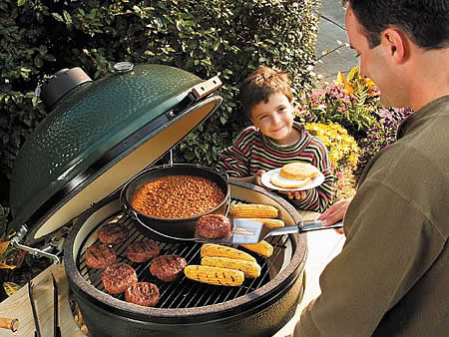


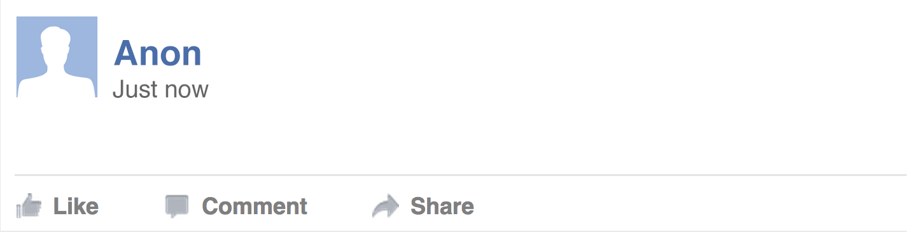




^{Facebook Data Insights}
Listen to the what the world’s largest focus group, Facebook’s 1.5 Billion users, have to say about BGE and the grill industry.
INTRODUCING FACEBOOK TOPIC DATA
Anonymous & aggregated Insights about specific activities, events, brand names, and other subjects that people are sharing on Facebook
TEXT ANALYSIS
DEMOGRAPHICS
Privacy-safe aggregate analysis of text e.g. Steak
Gender: Male
Age Range: 25-34
Region: Texas
CONTENT
CONTENT
Analyze
URLs shared
across Facebook
LINKS
SENTIMENT
CONTENT
There’s something unique about steak grilled on a Big Green Egg
Negative
Neutral
Positive
CONTENT
TOPIC ANALYSIS
ENGAGEMENT
Automatic classification
of related topics e.g. Big Green Egg
Engagement and Demographics around Likes, Comments and Shares
1

Slide 2
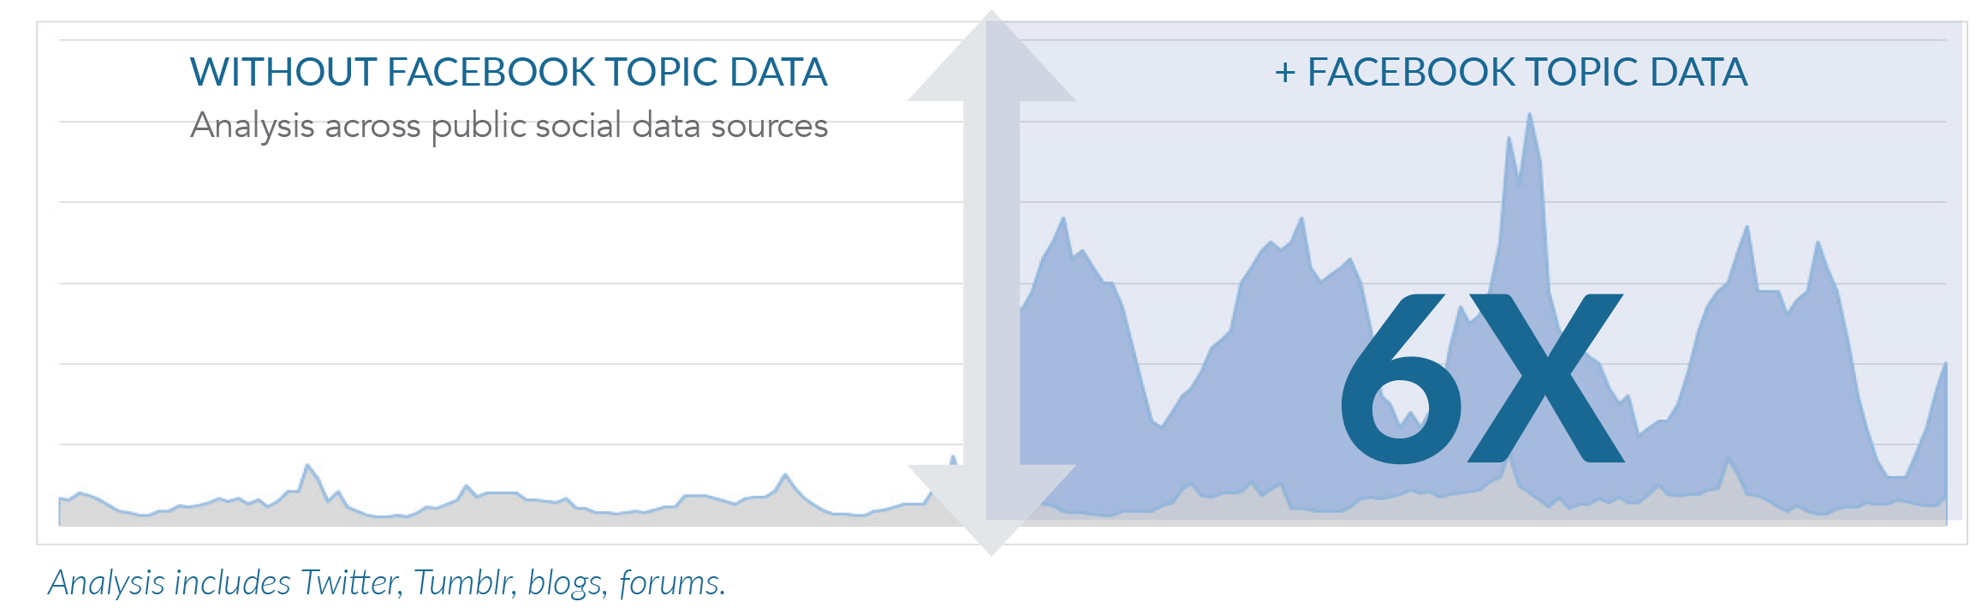

MAKE BETTER DECISIONS WITH INSIGHTS FROM 1.49 BILLION PEOPLE
Example: Analysis of automotive brand
^{PAGES VS TOPIC DATA COMPARISON}
TOPIC DATA
~70,000
Topic data expands your insights.
Facebook Pages
The audience that is engaging with your brand across Facebook.
What is driving brand recommendation, purchase, advocacy or churn.
Content that goes viral on Facebook
about your brand.
Audience reaction to multi-channel
marketing campaigns.
Comparison of volumes of engagement relating to an automotive brand across 7-day period.
~1,000
Brand – related Post and Engagement across all of Facebook
Posts and Engagement on your own Facebook Pages

Slide 3
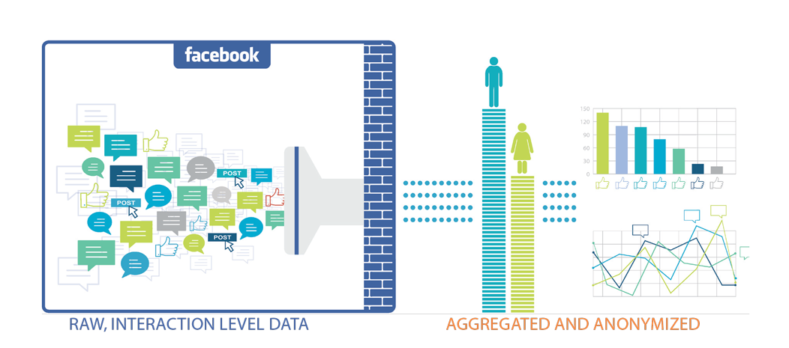




HOW COMPANIES ARE USING TOPIC DATA
Example: Analysis of automotive brand
BRAND • PRODUCT
CONTENT • LINKS
INDUSTRY • TOPIC
AUDIENCE
Brand Analytics
Content & Media Analysis
Industry & Topic Research
Market research to inform creative & campaigns
Brand Reputation Management
Campaign Analysis
Competitive Analysis
Influential Media Analysis
Topic Analysis
Content Discovery
Industry Benchmarking
Topic-Specific Analysis
Vertical Applications (e.g. TV)
Creative & Campaign Design
Audience Affinity Analysis
Audience Discovery/Expansion

Slide 4

Big Green Egg Industry Analysis
^{Search Keywords & Details}
KEYWORDS
The ﬁlter listened to any Facebook post, comment, like, or share that mentioned a keyword(s) relative to BGE or its industry
INTERACTIONS
496.1k interactions were analyzed from 1/15/2016- 1/16/2016
KEY LEARNINGS
Insightpool uncovered key insights pertaining to both demographics for inﬂuencers driving the conversation around the grill industry, as well as topical learnings to guide BGE’s strategy.
^{Demographics Info}
AGE
The leading age segment was 25-34 year-olds (28%) followed by 35-44 (23%) & 45-54 (17%).
GENDER
62% of the conversation came from females
REGION
The 5 top regions where the influencers were from were Texas, California, Florida, Georgia, and Illinois
SUMMARY
The average Intel inﬂuencer is a 25-34 year-old female from Texas.

Slide 5
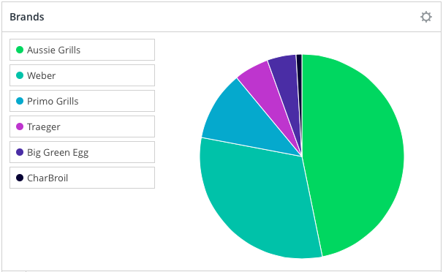
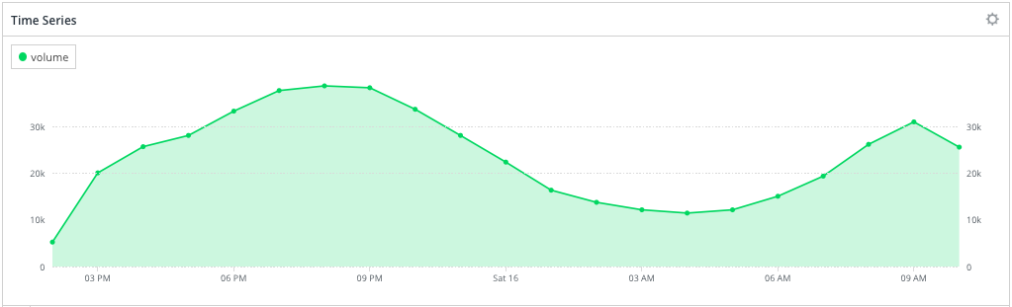
Big Green Egg Industry Analysis
There were a total of 946.1k interactions that made up the industry WOM in less than 24 hours. Only 10,900 interactions associated grilling with a specific brand. Of those interactions, Aussie Grills (47%) and Weber (31%) drove the majority of the conversation. BGE made up 5% of the brand mentions. Upon further analyzing the demographic data, Insightpool discovered that the conversation surrounding Aussie Grills is skewed 5% more towards females. Insightpool delivered similar insights for each brand.
Brands and Their Associated Demographic Nuances
Aussie Grills- 47%- 67% Female
Weber- 31%- #1 Region: Queensland, Australia
Primo Grills- 10%- 38% 35-44
Traeger- 6%- N/A
Big Green Egg- 5%- N/A
CharBroil- 1%- N/A
^{Timing of Interactions}
^{Grilling}
INSIGHTS
The grilling conversation did not fluctuate throughout the day as much as anticipated. Typical industry conversations have sharp peaks and lulls during the hours that their product/service is not relevant. The conversation peaked at 8:00 PM EST at 38.7k interactions while the lowest point of volume was at 4:00 AM EST, and the conversation was still above 10k interactions.

Slide 6
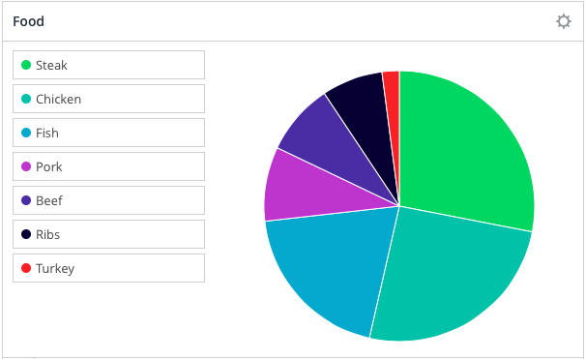
^{Topical Analysis}
#1 Food
Steak
Number Mentions
63,200
Suggestions
Steak was the number one food mentioned in the industry conversation. BGE could increase WOM market share by further associating ‘grilling steak’ and BGE
Types of Food
^{INSIGHT REVIEW}
INSIGHT #1
The average Intel inﬂuencer is a 25-34 year-old female from Texas.
INSIGHT #2
Aussie Grills (47%) and Weber (31%) drove the majority of the conversation. BGE made up 5% of the brand mentions. Aussie Grill influencers were skewed female while the region with the most Weber influencers (22%) was Queensland, Australia.
INSIGHT #3
The grilling conversation did not fluctuate throughout the day as much as anticipated. Typical industry conversations have sharp peaks and lulls during the hours that their product/service is not relevant. The conversation peaked at 8:00 PM EST at 38.7k interactions while the lowest point of volume was at 4:00 AM EST, and the conversation was still above 10k interactions.
INSIGHT #4
Steak was the number one food mentioned in the industry conversation. BGE could increase its WOM market share by further building an association between ‘grilling steak’ and BGE.

